Slide 1


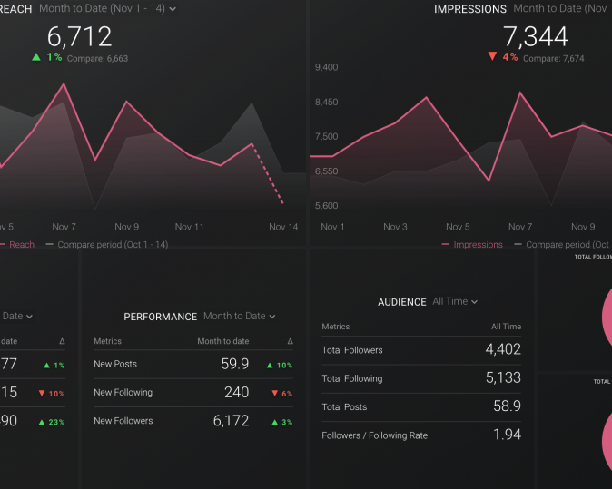
Instagram User Analytics
Instagram Analytics Report
Instagram User Analytics
Tips, Tools and Best Practices for Building a Great Report
100 Likes

Slide 2

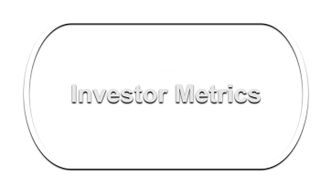
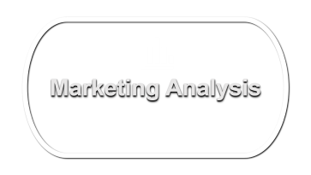
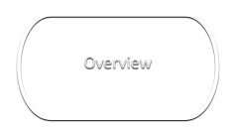
SQL Tasks :
A) Marketing Analysis:
Loyal User Reward: The marketing team wants to reward the most loyal users, i.e., those who have been using the platform for the longest time. Task: Identify the five oldest users on Instagram from the provided database.
Inactive User Engagement: The team wants to encourage inactive users to start posting by sending them promotional emails. Task: Identify users who have never posted a single photo on Instagram.
Contest Winner Declaration: The team has organized a contest where the user with the most likes on a single photo wins. Task: Determine the winner of the contest and provide their details to the team.
Hashtag Research: A partner brand wants to know the most popular hashtags to use in their posts to reach the most people. Task: Identify and suggest the top five most commonly used hashtags on the platform.
Ad Campaign Launch: The team wants to know the best day of the week to launch ads. Task: Determine the day of the week when most users register on Instagram. Provide insights on when to schedule an ad campaign.
B) Investor Metrics:
User Engagement: Investors want to know if users are still active and posting on Instagram or if they are making fewer posts. Task: Calculate the average number of posts per user on Instagram. Also, provide the total number of photos on Instagram divided by the total number of users.
Bots & Fake Accounts: Investors want to know if the platform is crowded with fake and dummy accounts. Task: Identify users (potential bots) who have liked every single photo on the site, as this is not typically possible for a normal user.

Slide 3


Marketing Analysis

Slide 4
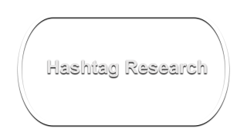
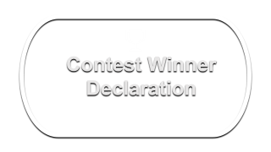
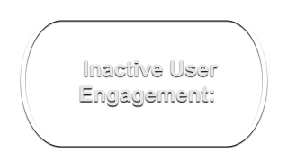
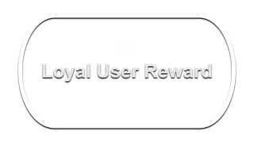

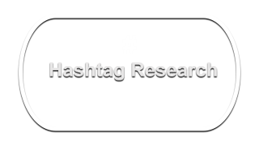
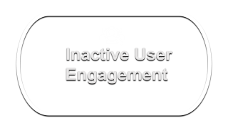
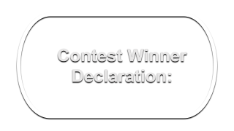
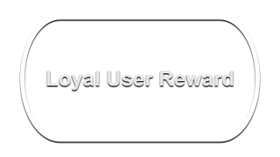

Marketing Analysis

Slide 5



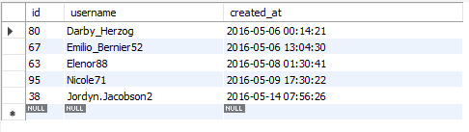
#Loyal User Reward: CODE
SELECT * FROM
users order by created_at
limit 5;
Loyal User Reward
Id | Username | Created at date and time
38 | Jordyn.Jacobson2 | 2016-05-14 07:56:26
63 | Elenor88 | 2016-05-08 01:30:41
67 | Emilio_Bernier52 | 2016-05-06 13:04:30
80 | Darby_Herzog | 2016-05-06 00:14:21
95 | Nicole71 | 2016-05-09 17:30:22

Slide 6
Loyal User Reward:
#Loyal User Reward: CODE
SELECT * FROM
users order by created_at
limit 5;
Id | Username | Created at date and time
38 | Jordyn.Jacobson2 | 2016-05-14 07:56:26
63 | Elenor88 | 2016-05-08 01:30:41
67 | Emilio_Bernier52 | 2016-05-06 13:04:30
80 | Darby_Herzog | 2016-05-06 00:14:21
95 | Nicole71 | 2016-05-09 17:30:22

Slide 7

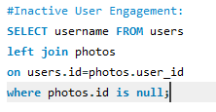
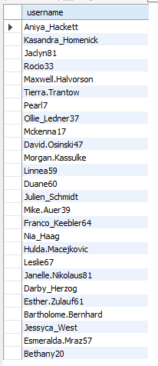
#Inactive User Engagement: CODE
SELECT username FROM users
left join photos
on users.id=photos.user_id
where photos.id is null;
Inactive User Engagement
USERNAME
Aniya_Hackett
Kasandra_Homenick
Jaclyn81
Rocio33
Maxwell.Halvorson
Tierra.Trantow
Pearl7
Ollie_Ledner37
Mckenna17
David.Osinski47
Morgan.Kassulke
Linnea59
Duane60
Julien_Schmidt
Mike.Auer39
Franco_Keebler64
Nia_Haag
Hulda.Macejkovic
Leslie67
Janelle.Nikolaus81
Darby_Herzog
Esther.Zulauf61
Bartholome.Bernhard
Jessyca_West
Esmeralda.Mraz57
Bethany20

Slide 8
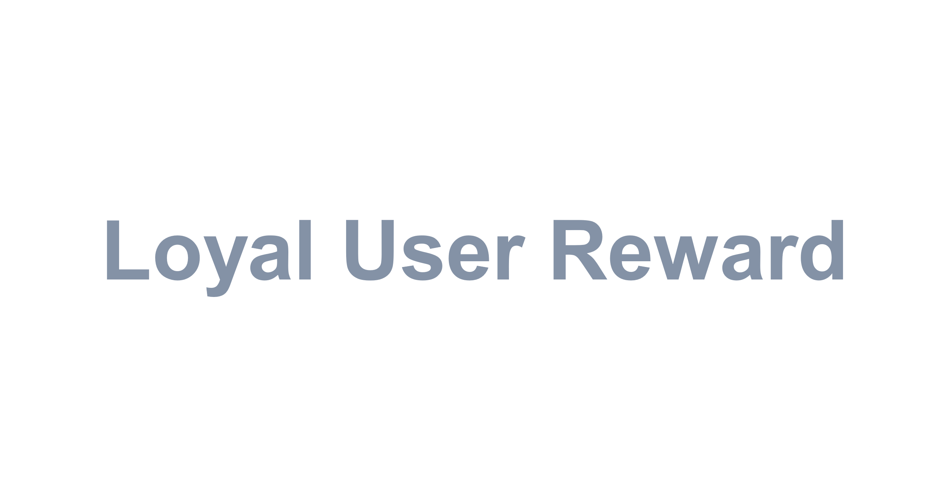
Inactive User Engagement
#Inactive User Engagement: CODE
SELECT username FROM users
left join photos
on users.id=photos.user_id
where photos.id is null;
USERNAME
Aniya_Hackett
Kasandra_Homenick
Jaclyn81
Rocio33
Maxwell.Halvorson
Tierra.Trantow
Pearl7
Ollie_Ledner37
Mckenna17
David.Osinski47
Morgan.Kassulke
Linnea59
Duane60
Julien_Schmidt
Mike.Auer39
Franco_Keebler64
Nia_Haag
Hulda.Macejkovic
Leslie67
Janelle.Nikolaus81
Darby_Herzog
Esther.Zulauf61
Bartholome.Bernhard
Jessyca_West
Esmeralda.Mraz57
Bethany20

Slide 9

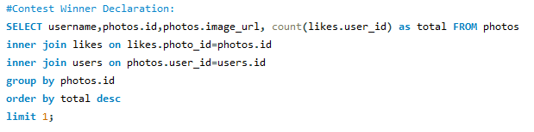

#Contest Winner Declaration:CODE
SELECT username,photos.id,photos.image_url, count(likes.user_id) as total FROM photos
inner join likes onlikes.photo_id=photos.id
inner join users on photos.user_id=users.id
group by photos.id
order by total desc
limit 1;
Contest Winner Declaration
Username | Id | Image_url | Total
Zack_Kemmer93 | 145 | https://jarret.name | 48

Slide 10
Contest Winner Declaration
#Contest Winner Declaration:CODE
SELECT username,photos.id,photos.image_url, count(likes.user_id) as total FROM photos
inner join likes onlikes.photo_id=photos.id
inner join users on photos.user_id=users.id
group by photos.id
order by total desc
limit 1;
Username | Id | Image_url | Total
Zack_Kemmer93 | 145 | https://jarret.name | 48

Slide 11
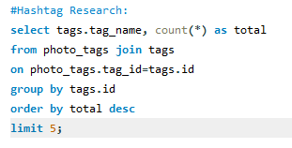
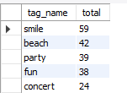
#
#Hashtag Research:CODE
select tags.tag_name, count(*) as total
from photo_tags join tags
on photo_tags.tag_id=tags.id
group by tags.id
order by total desc
limit 5;
Hashtag Research
Tag_Name | Total
smile | 59
beach | 42
party | 39
fun | 38
concert | 24

Slide 12
#
Hashtag Research
#Hashtag Research:CODE
select tags.tag_name, count(*) as total
from photo_tags join tags
on photo_tags.tag_id=tags.id
group by tags.id
order by total desc
limit 5;
Tag_Name | Total
smile | 59
beach | 42
party | 39
fun | 38
concert | 24

Slide 13

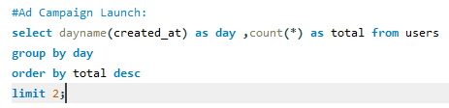

#Ad Campaign Launch:
select dayname(created_at) as day ,
count(*) as total from users
group by day
order by total desc
limit 2;
Ad Campaign Launch
Day | Total
Thursday | 16
Sunday | 16

Slide 14
Ad Campaign Launch
#Ad Campaign Launch:
select dayname(created_at) as day ,
count(*) as total from users
group by day
order by total desc
limit 2;
Day | Total
Thursday | 16
Sunday | 16

Slide 15

Investor Metrics

Slide 16
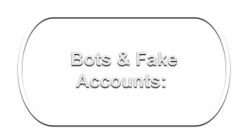
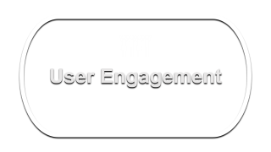
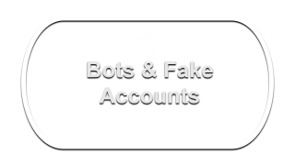
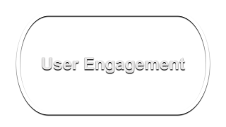
Investor Metrics

Slide 17

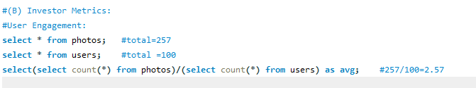

#User Engagement:
select * from photos; #total=257
select * from users; #total =100
select(select count(*) from photos)/
(select count(*) from users) as avg;
#257/100=2.57
User Engagement
Avrage
2.5700

Slide 18
User Engagement
#User Engagement:
select * from photos; #total=257
select * from users; #total =100
select(select count(*) from photos)/
(select count(*) from users) as avg;
#257/100=2.57
Avrage
2.5700

Slide 19

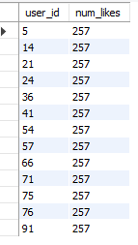
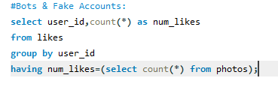
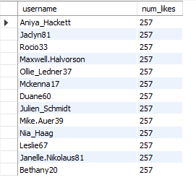
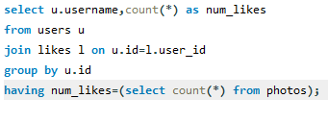
#Bots & Fake:CODE Accounts:select user_id,count(*) as num_likes from likesgroup by user_idhaving num_likes=(select count(*) from photos);
Bots & Fake Accounts
select u.username,
count(*) as num_likes
from users u
join likes l on u.id=l.user_id group by u.id
having num_likes=(select count(*) from photos);

Slide 20
Bots & Fake Accounts
#Bots & Fake:CODE Accounts:select user_id,count(*) as num_likes from likesgroup by user_idhaving num_likes=(select count(*) from photos);
select u.username,
count(*) as num_likes
from users u
join likes l on u.id=l.user_id group by u.id
having num_likes=(select count(*) from photos);

Slide 21

Project Description: This project aims to analyze Instagram user data to gain insights into user behavior, engagement, and demographics. By leveraging SQL fundamentals, we can extract, transform, and analyze the data to understand user trends and patterns.
Approch:1.Data Collection 2. Data Exploration 3. Data Cleaning and Preparation 4. SQL Query Development 5. Query Execution and Analysis 6.Visualization and Reporting 7. Validation and Iteration 8. Documentation and Presentation.
Overview
Tech-Stack Used: MySQL Workbench
SQL Workbench can be a valuable tool in the Instagram User Analytics project for Database Management
Insights:User Demographics Engagement ,Metrics Top-Performing Content, User Behavior Analysis, Trend Analysis ,Influencer Insights ,Cross-Platform Analysis
Result:The project's focus on leveraging SQL and Given Data for analysis underscores the significance of data-driven decision-making in driving business growth and enhancing user experience on digital platforms.

Slide 22
Overview
Project Description: This project aims to analyze Instagram user data to gain insights into user behavior, engagement, and demographics. By leveraging SQL fundamentals, we can extract, transform, and analyze the data to understand user trends and patterns.
Approch:1.Data Collection 2. Data Exploration 3. Data Cleaning and Preparation 4. SQL Query Development 5. Query Execution and Analysis 6.Visualization and Reporting 7. Validation and Iteration 8. Documentation and Presentation.
Tech-Stack Used: MySQL Workbench
SQL Workbench can be a valuable tool in the Instagram User Analytics project for Database Management
Insights:User Demographics Engagement ,Metrics Top-Performing Content, User Behavior Analysis, Trend Analysis ,Influencer Insights ,Cross-Platform Analysis
Result:The project's focus on leveraging SQL and Given Data for analysis underscores the significance of data-driven decision-making in driving business growth and enhancing user experience on digital platforms.

Slide 23
THANK YOU

